Slide 1
Spectral Clustering
Using Graph Theory to Identify Clusters with Complex Shapes
Mariss Haddad & Pruthvi Raj

Slide 2
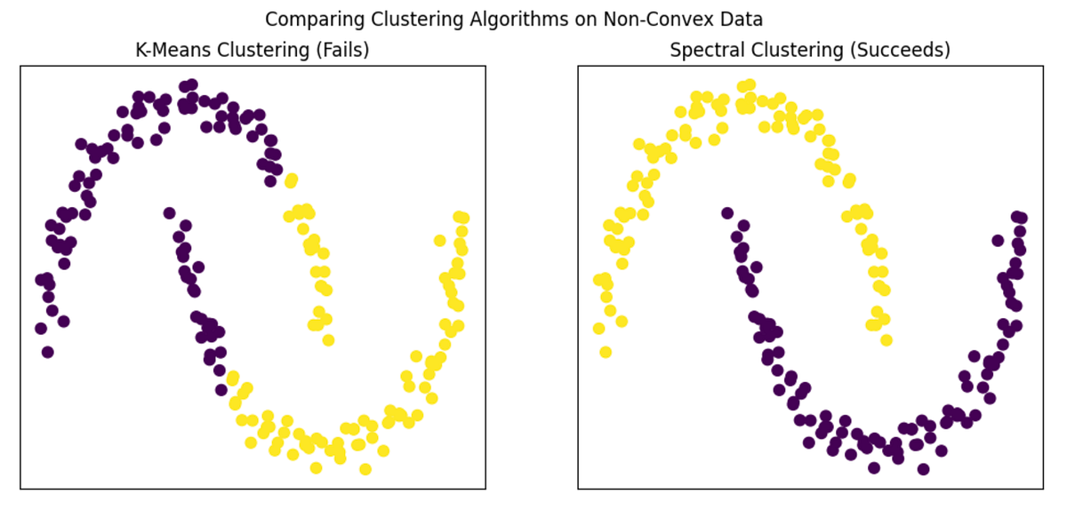
Intro to Spectral Clustering
What is spectral clustering?
Graph-based clustering approach
Leverages new feature space made from eigenvalues/eigenvectors of similarity matrix
How is spectral clustering different from traditional methods like K-means?
It is able to capture complex and non-convex shapes
It is effective for clusters with non-linear and unusual geometries
It requires more computational power and is sensitive to scaling
Images from https://dilipkumar.medium.com/spectral-clustering-algorithm-03a62854d19b

Slide 3
Spectral Clustering Algorithm
Applications & Usage
Construct similarity matrix
Compute graph Laplacian
Use eigenvectors as feature representation
Apply clustering in transformed space
Applications of Spectral Clustering
How to Implement Spectral Clustering (ext)

Slide 4
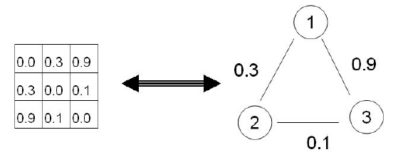
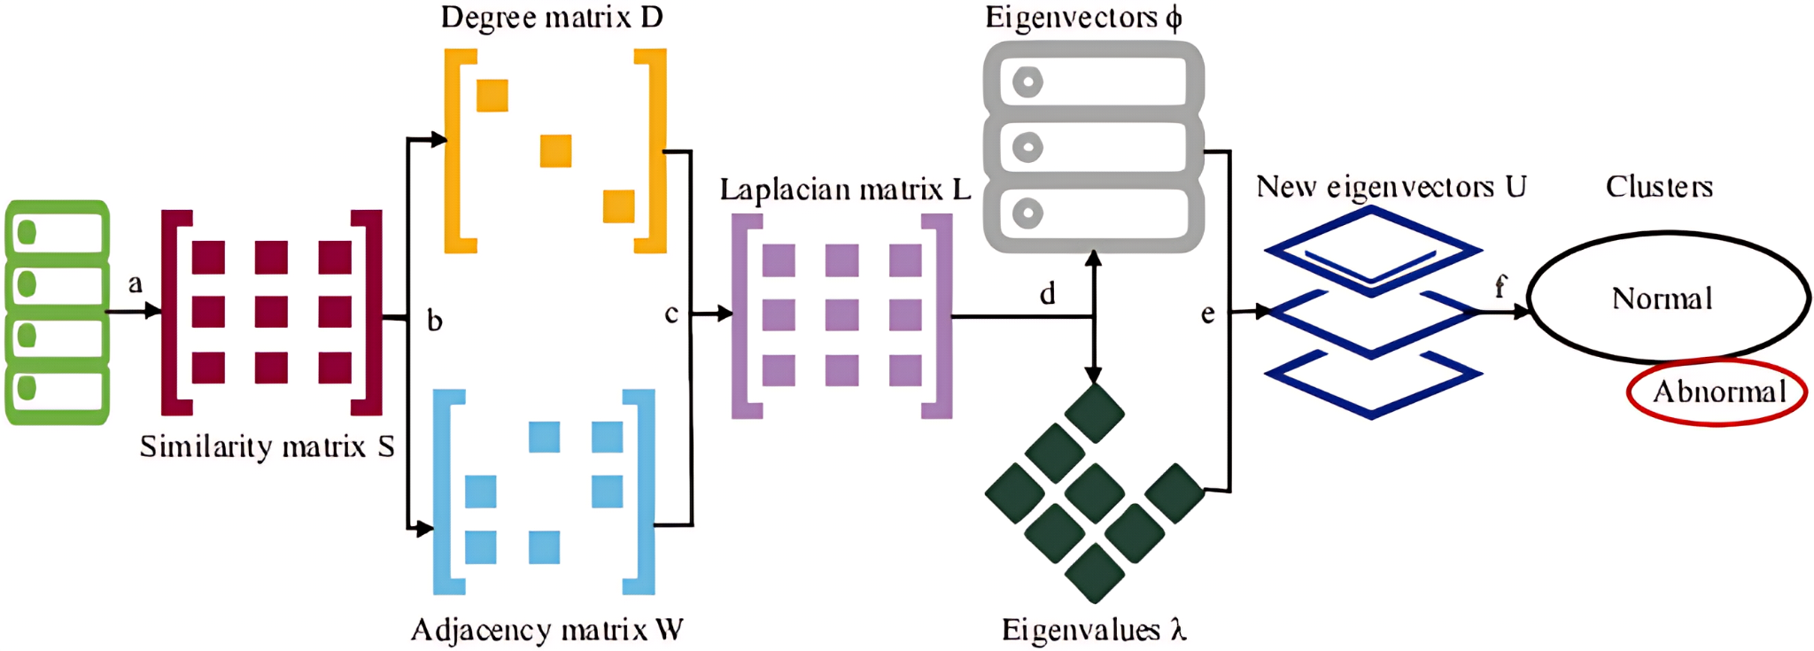
1. Construct Similarity Matrix
First, assemble the similarity matrix S based on the data points
Nodes = data points
Edges = similarities
Similarities between the data points can be calculated using:
K-nearest neighbors (KNN) algorithm
Gaussian kernel
Euclidean distance
And more
Below is a simple example of a similarity matrix representation of a graph
Images from https://www.researchgate.net/figure/Flowchart-of-the-spectral-clustering-
algorithm-a-Construct-the-similarity-matrix-S-of_fig3_384116323 https://www.researchgate.net/figure/Graph-and-similarity-matrix-connection_fig4_242508535

Slide 5

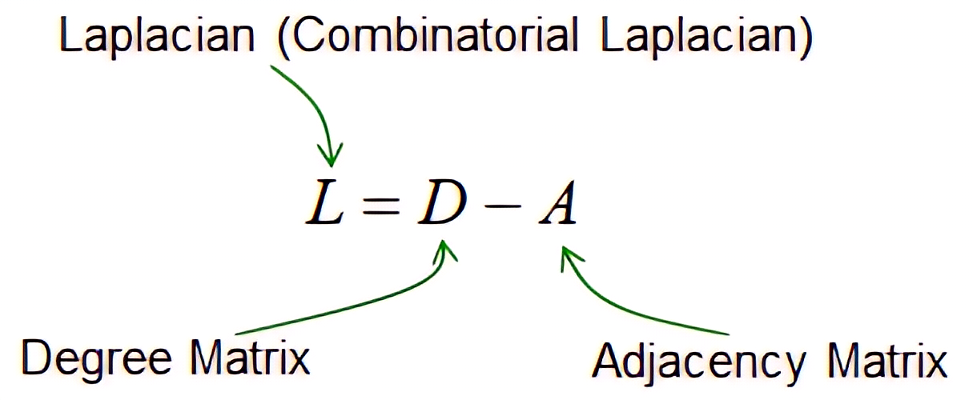
2. Construct Graph Laplacian
Using a threshold value to determine connection strength cutoff between data points, convert the similarity matrix S into an adjacency matrix A (or W) and a degree matrix D
From the resulting degree matrix and adjacency matrix, calculate the graph Laplacian matrix L
Whereas the similarity matrix told us how similar the points are, the graph Laplacian matrix encodes the structure of the connections
This will allow us to extract information about global cluster structure in the next step
Images from https://www.researchgate.net/figure/Flowchart-of-the-spectral-clustering-
algorithm-a-Construct-the-similarity-matrix-S-of_fig3_384116323
https://www.sharetechnote.com/html/Handbook_EngMath_GraphTheory_LaplacianMatrix.html

Slide 6
3. Use Eigenvectors as Feature Representation
Choose the number of clusters desired, k, and compute the first k eigenvectors of the graph Laplacian
Stack those eigenvectors to form matrix U, which has the size n x k
n = number of data points
K = number of clusters chosen
This means that each data point is now represented by a row of U
This results in a new lower-dimension feature representation that preserves global clustering
Strongly connected points -> Similar eigenvector values -> Close together in new space
Image from https://www.researchgate.net/figure/Flowchart-of-the-spectral-clustering-
algorithm-a-Construct-the-similarity-matrix-S-of_fig3_384116323

Slide 7
4. Apply Clustering in Transformed Space
Finally, partition the embedding graph into clusters using a traditional clustering algorithm
A method like k-means clustering can be applied in the new transformed space
The previous steps have already done the heavy lifting for k-means
Points that are strongly connected in the original graph have similar eigenvector values
These points naturally group together in the eigenvector space
K-means can now easily separate these groups with simple boundaries
This allows for unusual cluster shapes to be detected
Concentric circles
Spirals
Highly non-linear shapes
Non-convex shapes
Image from https://www.researchgate.net/figure/Flowchart-of-the-spectral-clustering-
algorithm-a-Construct-the-similarity-matrix-S-of_fig3_384116323

Slide 8
Applications of Spectral Clustering
Computer Vision: Image Segmentation
Identify irregular object boundaries
Divide an image into meaningful regions
Example: Separating a person from a complex background
Social Network Analysis: Community Detection
Identify groups of people with strong connections
Reveal hidden community structures in large networks
Example: Social media groupings, industrial or academic collaboration networks
Bioinformatics: Gene Expression Analysis
Cluster genes with similar expression patterns across many different conditions
Cluster proteins with functional similarity
Spatial Data & GIS: Geographical Clustering
Identify regions with similar complex characteristics
Handle irregular geographic boundaries naturally
Example: Mapping an ecological habitat

Slide 9
How to Implement Spectral Clustering
(screen will now be shared)

